Slide 1
COMP 2230
Week 9 - Friday

Slide 2
Last time
Finished pigeonhole principle
Combinations
Combinations with replacement
Started binomial theorem

Slide 3
Questions?

Slide 4
Assignment 4

Slide 5
Logical warmup
Draw a (non-self-intersecting) hexagon that can be cut into four congruent triangles by a single line
Hint: Try to make it out of right triangles

Slide 6
Binomial Matters

Slide 7

Pascal's Triangle
The beginning of Pascal's Triangle is:
If we number rows and columns starting at $0$, note that the value of row $n$, column $r$ is exactly $\left(\begin{matrix}n \\ r\end{matrix}\right)$
1
1 | 1
1 | 2 | 1
1 | 3 | 3 | 1
1 | 4 | 6 | 4 | 1
1 | 5 | 10 | 10 | 5 | 1
1 | 6 | 15 | 20 | 15 | 6 | 1

Slide 8
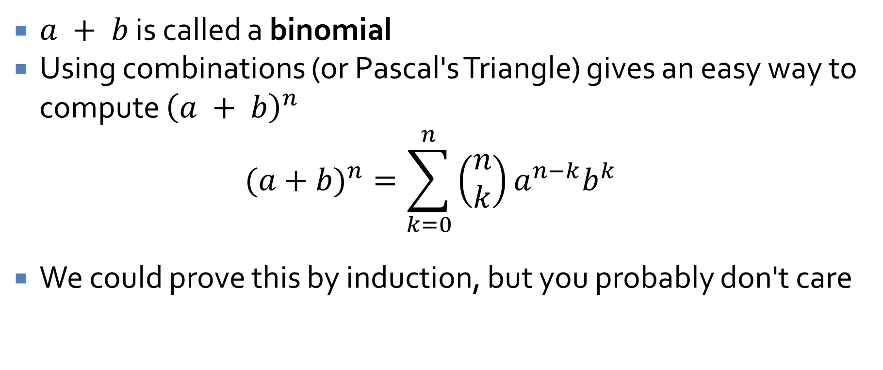
Binomial theorem
$a + b$ is called a binomial
Using combinations (or Pascal's Triangle) gives an easy way to compute ${\left(a + b\right)}^{n}$
$$(a+b)^{n}=\sum_{k=0}^{n}{\left(\begin{matrix}n \\ k\end{matrix}\right)}a^{n−k}b^{k}$$
We could prove this by induction, but you probably don't care

Slide 9

Binomial example
Compute ${\left(1 – x\right)}^{6}$ using the binomial theorem
Now try ${\left(6a + 2b\right)}^{7}$

Slide 10
Probability Axioms and Expected Value

Slide 11
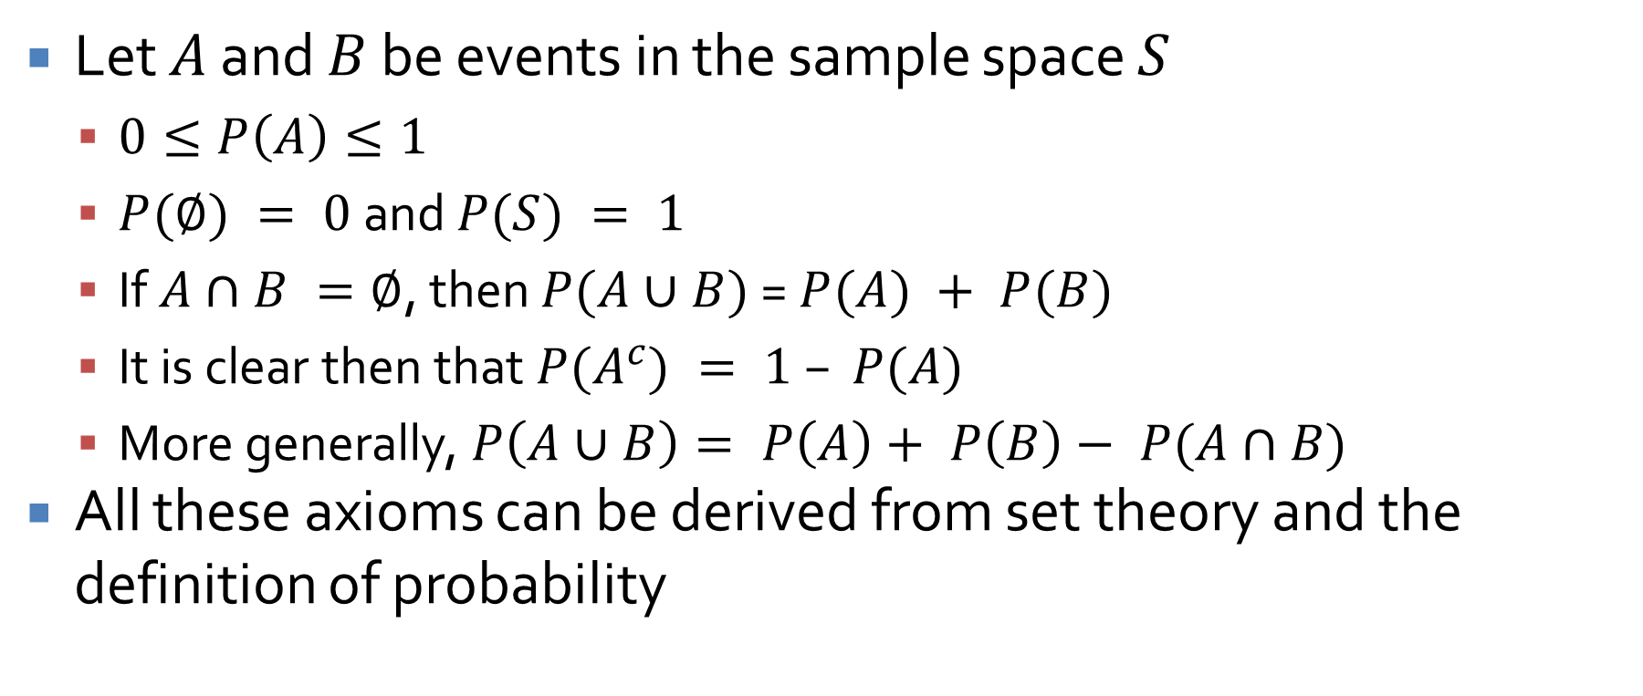
Probability axioms
Let $A$ and $B$ be events in the sample space $S$
  $0≤P\left(A\right)≤1$
  $P(∅) = 0$ and $P(S) = 1$
  If $A∩B =∅$, then $P(A∪B)$ = $P(A) + P(B)$
  It is clear then that $P(A^{c}) = 1 – P(A)$
  More generally, $P\left(A∪B\right)= P\left(A\right)+ P\left(B\right)− P(A∩B)$
All these axioms can be derived from set theory and the definition of probability

Slide 12
Union probability example
What is the probability that a card drawn randomly from an Anglo-American 52 card deck is a face card (jack, queen, or king) or is red (hearts or diamonds)?
Hint:
  Compute the probability that it is a face card
  Compute the probability that it is red
  Compute the probability that it is both

Slide 13
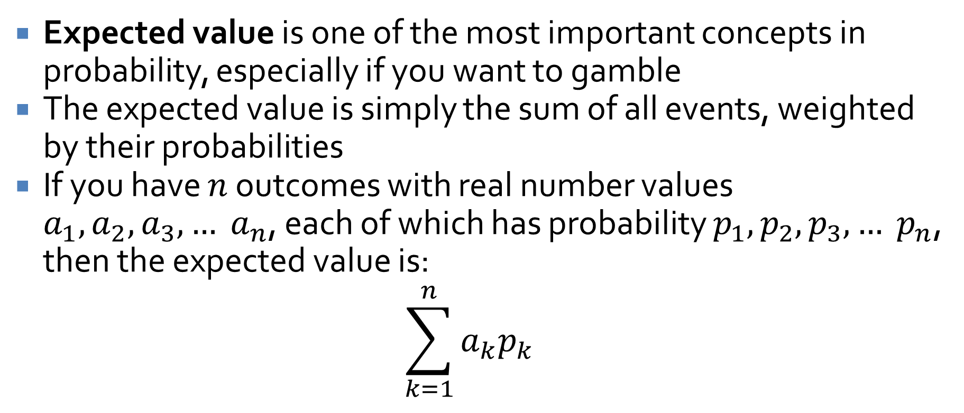
Expected value
Expected value is one of the most important concepts in probability, especially if you want to gamble
The expected value is simply the sum of all events, weighted by their probabilities
If you have $n$ outcomes with real number values $a_{1}, a_{2}, a_{3},… a_{n}$, each of which has probability $p_{1}, p_{2}, p_{3},… p_{n}$, then the expected value is:
$$\sum_{k=1}^{n}{a_{k}p_{k}}$$

Slide 14

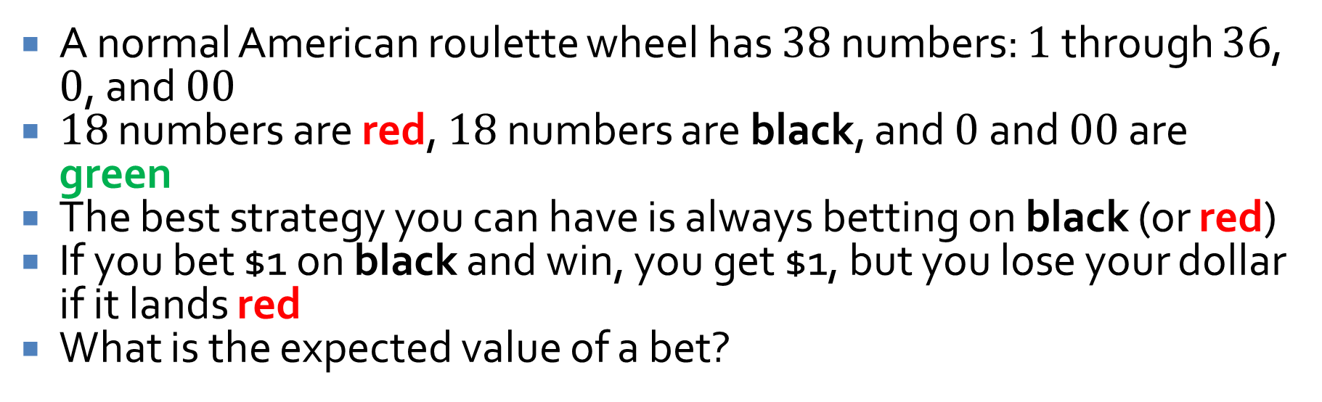
Expected value: Roulette
A normal American roulette wheel has $38$ numbers: $1$ through $36$, $0$, and $00$
$18$ numbers are red, $18$ numbers are black, and $0$ and $00$ are green
The best strategy you can have is always betting on black (or red)
If you bet $1 on black and win, you get $1, but you lose your dollar if it lands red
What is the expected value of a bet?

Slide 15
Conditional Probability
Three-Sentence Summary

Slide 16
Conditional Probability

Slide 17
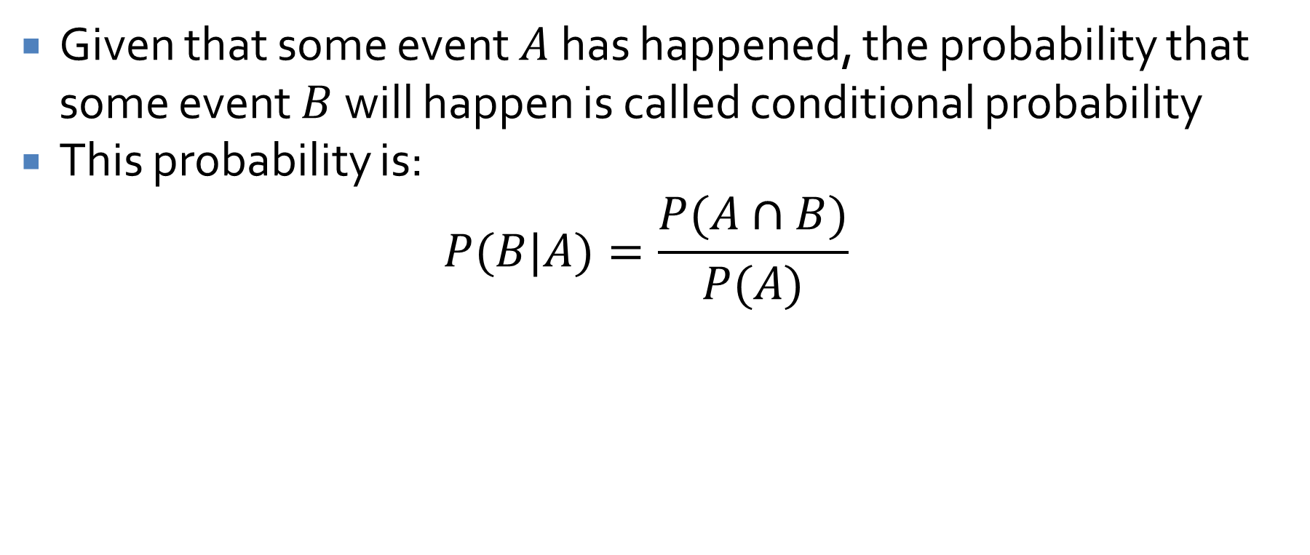
Conditional probability
Given that some event $A$ has happened, the probability that some event $B$ will happen is called conditional probability
This probability is:
$$P(B|A)=\frac{P(A∩B)}{P(A)}$$

Slide 18
Conditional probability example
Given two, fair, 6-sided dice, what is the probability that the sum of the numbers they show when rolled is 8, given that both of the numbers are even?

Slide 19
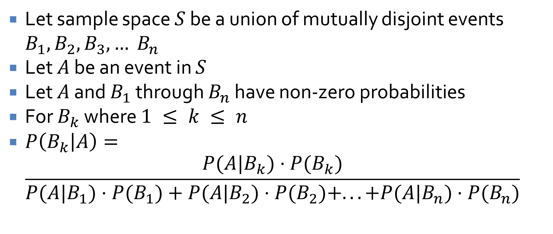
Bayes' Theorem
Let sample space $S$ be a union of mutually disjoint events $B_{1}, B_{2}, B_{3}, … B_{n}$
Let $A$ be an event in $S$
Let $A$ and $B_{1}$ through $B_{n}$ have non-zero probabilities
For $B_{k}$ where $1 ≤ k ≤ n$
$P\left(B_{k} | A\right)=$
$$\frac{P(A|B_{k})⋅P(B_{k})}{P(A|B_{1})⋅P(B_{1})+P(A|B_{2})⋅P(B_{2})+...+P(A|B_{n})⋅P(B_{n})}$$

Slide 20
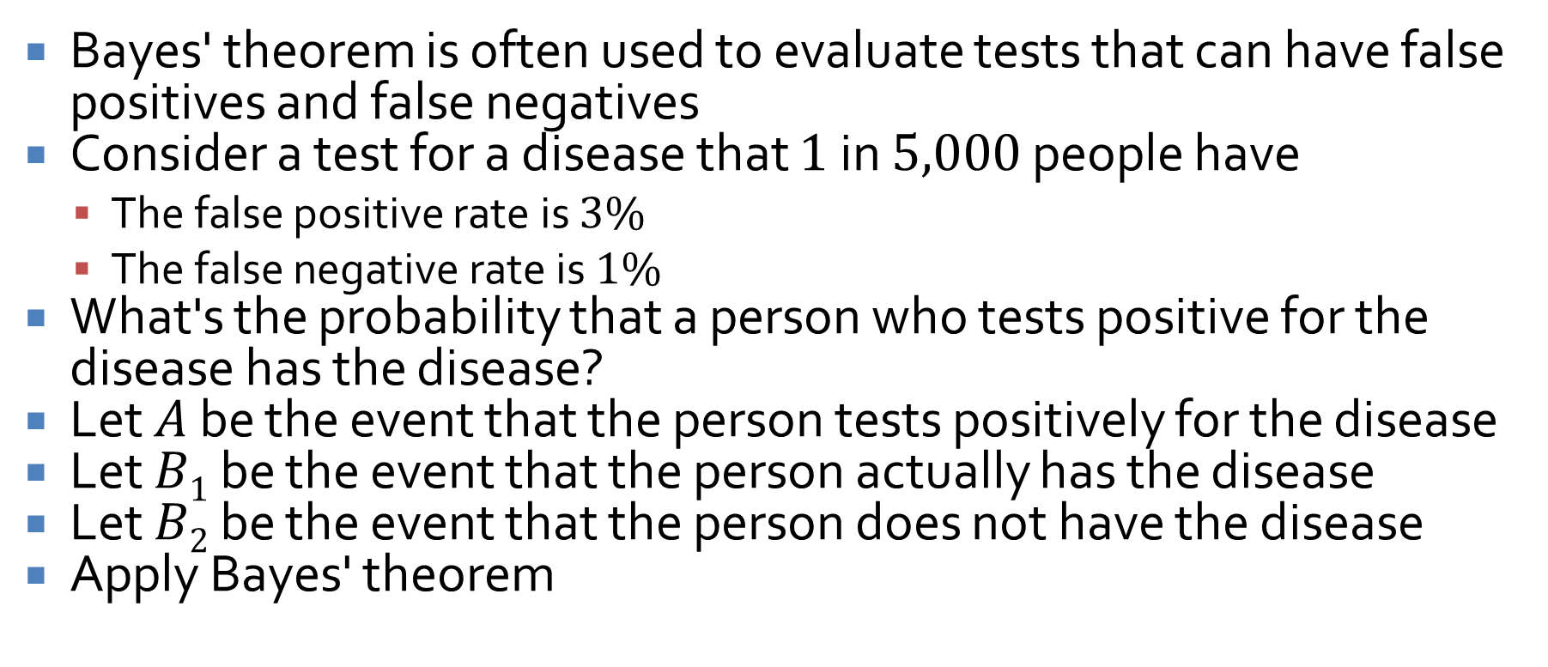
Applying Bayes' theorem
Bayes' theorem is often used to evaluate tests that can have false positives and false negatives
Consider a test for a disease that $1$ in $5,000$ people have
  The false positive rate is $3\%$
  The false negative rate is $1\%$
What's the probability that a person who tests positive for the disease has the disease?
Let $A$ be the event that the person tests positively for the disease
Let $B1$ be the event that the person actually has the disease
Let $B2$ be the event that the person does not have the disease
Apply Bayes' theorem

Slide 21
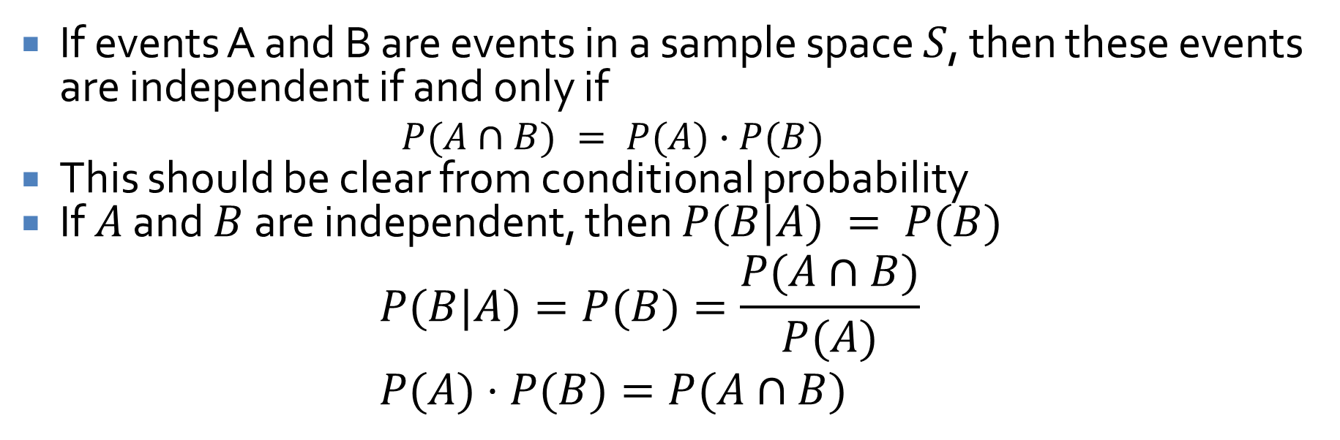
Independent events
If events A and B are events in a sample space $S$, then these events are independent if and only if
  $$P(A∩B) = P(A)∙P(B)$$
This should be clear from conditional probability
If $A$ and $B$ are independent, then $P(B|A) = P(B)$
$$P(B|A)=P(B)=\frac{P(A∩B)}{P(A)} \\ P(A)⋅P(B)=P(A∩B)$$

Slide 22
Upcoming

Slide 23
Next time…
Graphs: trails, paths, and circuits
No class next week!

Slide 24
Reminders
Finish Assignment 4
  Due tonight by midnight!
Read 10.1
  Prepare a three-sentence summary
  Extra credit if you get called on

